Slide 1


AI-Enhanced E-Learning Platform for the Hearing impaired
24-25j-281
05.12.2024

Slide 2
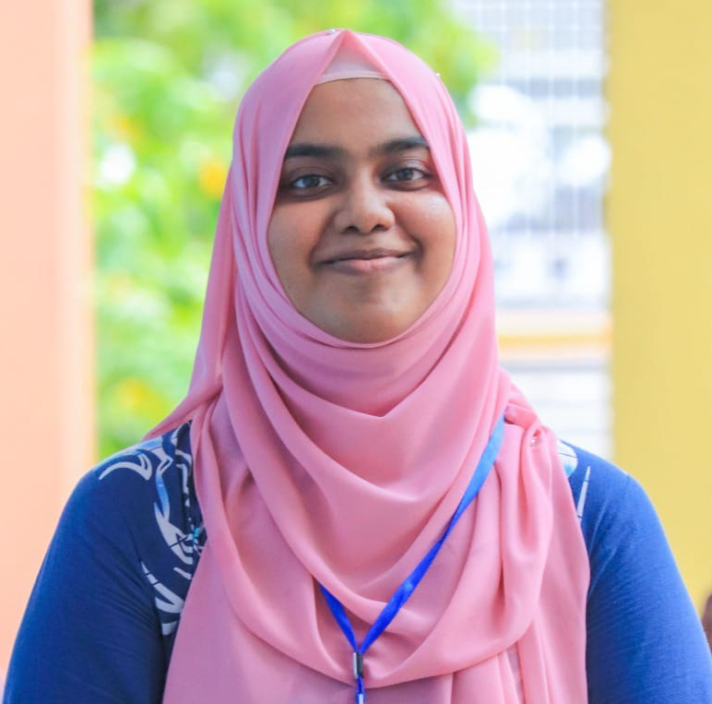
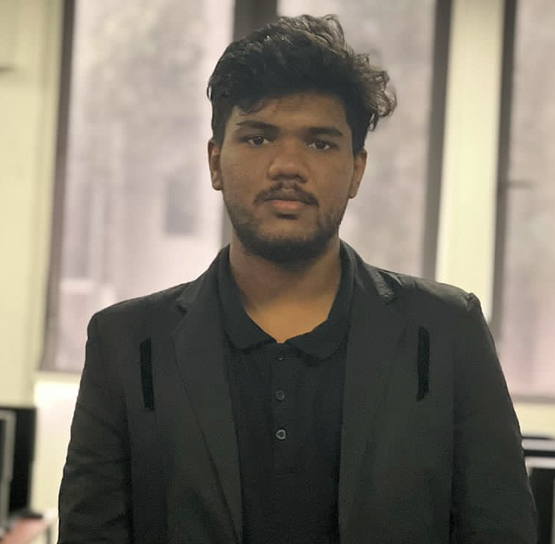

Team Members
M.S.M Shazny zIT211736322
Saliha Rizan
IT21311840
Z.F. Sahla
IT21159558
Supervisor – Ms. Thamali Kelegama
Co- Supervisor – Ms. Vindhya Kalapuge
External Supervisor – Ms. Fathima Roshan Shafeedha Rizan
24-25j-281
05.12.2024

Slide 3
Team Members
Rizan S
IT21311840
M.S.M Shazny zIT211736322
Z.F. Sahla
IT21159558
24-25j-281
05.12.2024

Slide 4
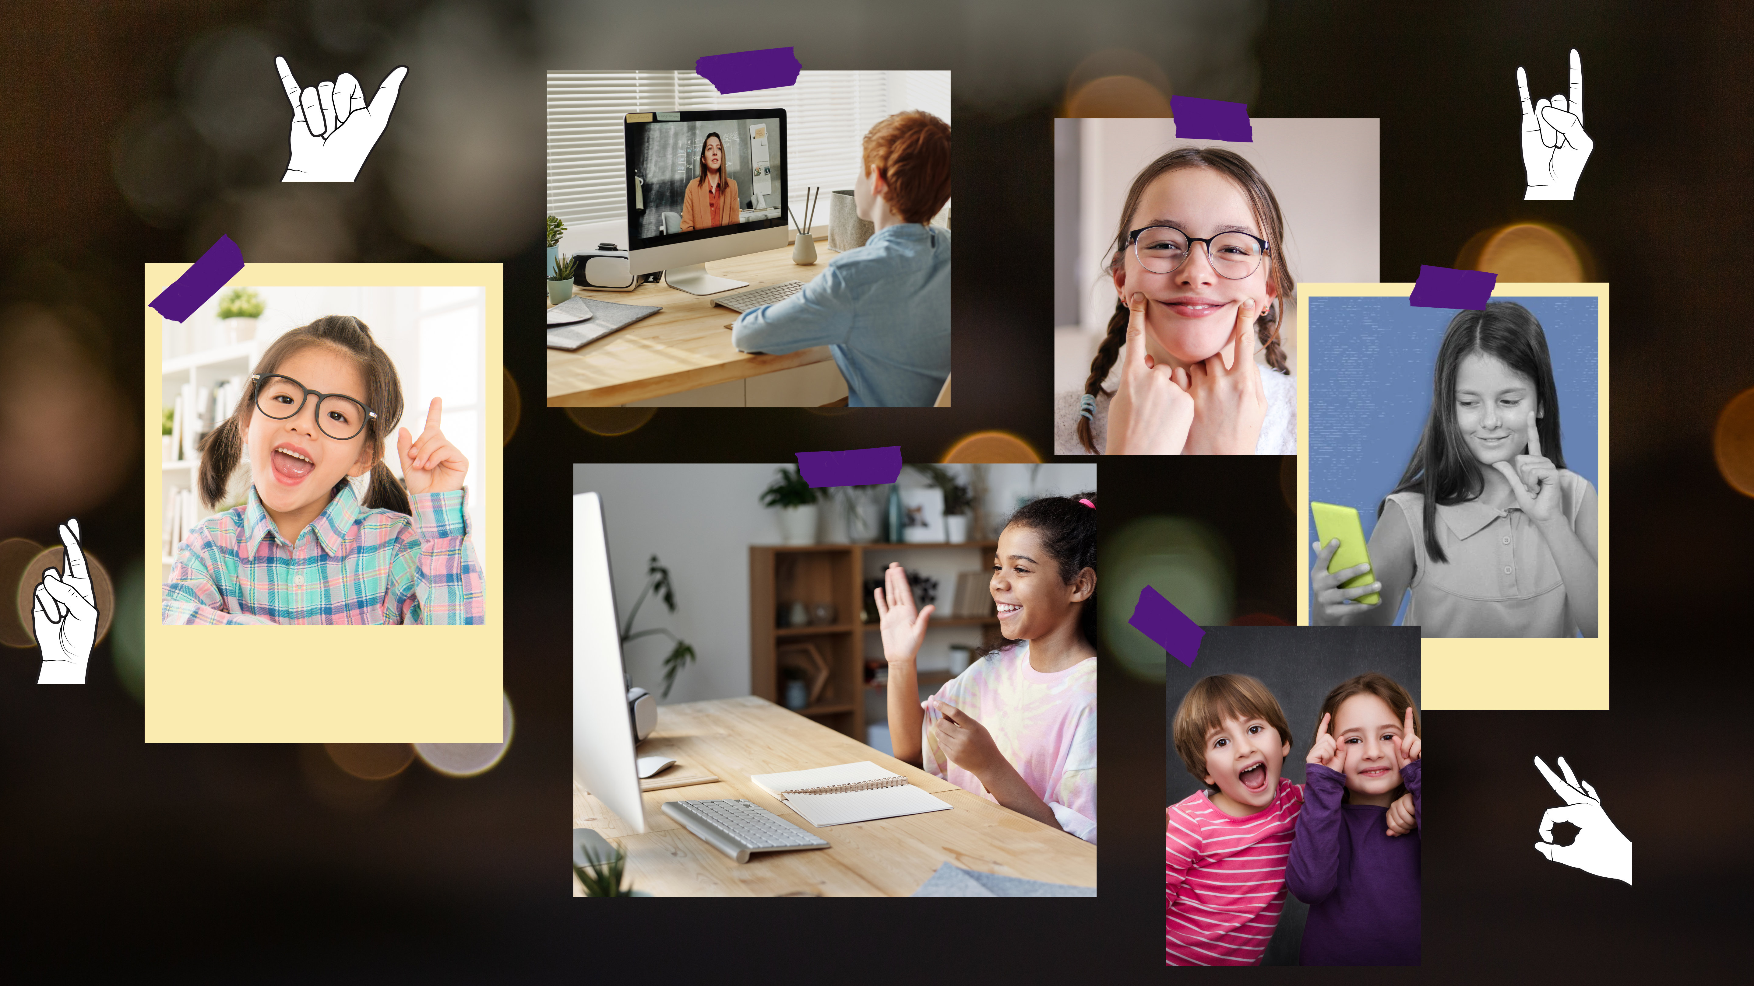
Introduction
This research addresses the significant barriers encountered by hearing-impaired children in accessing traditional e-learning environments.
Emphasizes the need for a tailored learning experience utilizing AI to translate educational content into sign language, ensuring inclusivity.
The solution integrates advanced technologies such as augmented reality and machine learning to enhance interaction and learning outcomes.
05.12.2024
Notes:
Our project addresses the barriers faced by hearing-impaired children in accessing traditional e-learning environments. These children often miss out on effective learning because existing platforms aren't inclusive.
To solve this, we propose using AI to translate educational content into sign language. Additionally, we integrate advanced technologies such as augmented reality and machine learning to make learning more interactive and effective.

Slide 5


05.12.2024

Slide 6

01
02
03
04
05
What are the most effective machine learning models for real-time gesture recognition in ASL learning?
How can augmented reality (AR) enhance the learning of American Sign Language (ASL) gestures in children with speech disorders?
How can performance prediction and personalized course recommendations optimize learning paths for children with speech disorders?
What is the impact of AI-driven interaction, such as chatbots and gesture-based communication, on children's speech therapy engagement and outcomes?
How can a real-time translation system bridge the gap between educational content and hearing-impaired children by providing captions and synchronized sign language?
05.12.2024

Slide 7
Main Objective
Sub Objective
To develop an interactive and robust system that identifies and treats speech disorders, specifically articulation errors and stuttering, in children aged between 4 to 12, by utilizing advanced technologies such as Augmented Reality (AR), Machine Learning (ML), and Natural Language Processing (NLP) to provide personalized, effective, and engaging speech therapy.
Augmented Reality for ASL Learning
Develop interactive AR modules that teach and practice American Sign Language (ASL) gestures with real-time feedback, enhancing the learning experience through dynamic simulations and immediate corrections.
Real-Time Translation of Educational Content
Implement a system that converts audio from educational videos into real-time captions and synchronized sign language, integrating speech recognition and translation for seamless learning experiences.
AI Assistant for Interaction and Support
Build an AI-driven assistant capable of interacting with children using both text and sign language, offering support for doubt clarification and providing personalized course recommendations based on performance.
Gesture Recognition for ASL
Develop machine learning models to recognize ASL gestures through computer vision techniques (such as CNNs) and provide real-time feedback to the users, helping them practice and correct their gestures.
Performance Prediction and Personalized Recommendations
Utilize machine learning algorithms for predicting students' learning progress and provide personalized course recommendations based on their quiz performance, improving engagement and therapy outcomes.
Objectives
05.12.2024

Slide 8
Main Objective
Sub Objective
AI-enhanced e-learning platform specifically designed for students aged 4 - 12, those who are hearing-impaired. This platform will leverage Augmented Reality, real-time translation technologies, and adaptive AI assistance to create a fully inclusive and personalized educational experience. It aims to facilitate seamless access to learning materials through real-time captions, sign language interpretation, and interactive support, while dynamically adapting to the individual learning styles and needs of young learners to enhance their engagement and educational outcomes.
Interactive ASL learning sessions using AR and Machine Learning
Real-Time Translation of Educational Content to captions, sign language and providing summary.
AI powered personalized learning assistant with sign language support

Slide 9
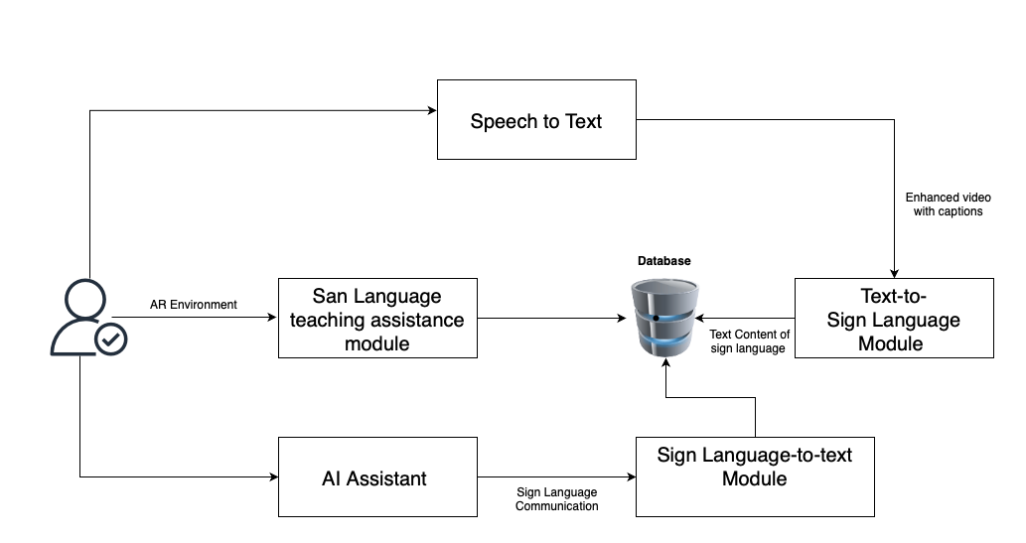
System Diagram
05.12.2024

Slide 10

Rizan S - IT21311840
Specialization : Interactive Media
10
Rizan S – IT21311840
05.12.2024

Slide 11

Background
AR Module to teach sign language with virtual hands performing gestures.
Machine Learning for real-time feedback on students' gestures.
Curriculum divided into 3 levels: Beginner, Intermediate, and Advanced.Testing modules to evaluate student progress.
Combines AR and ML to create an engaging, interactive learning experience.
11
Rizan S – IT21311840
05.12.2024

Slide 12
Research Gap
Most sign language apps use pictures or videos but don’t allow interaction.
Many apps don’t provide real-time feedback, so you might not know if you're doing it right.
This project is different:
Uses Augmented Reality (AR) to show virtual hands performing signs.
Provides real-time feedback to tell you if you're doing the signs correctly.
Allows you to practice sign language in a fun, interactive way.

Slide 13

Research Question
How can Augmented Reality help kids learn sign language in a fun and interactive way?
Rizan S – IT21311840
05.12.2024

Slide 14
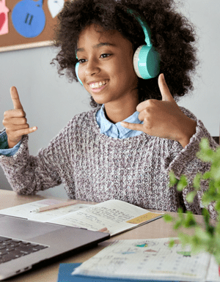
Specific & Sub Objectives
Create an app that shows 3D sign language signs using AR.
Let you practice making signs with your hands.
Provide real-time feedback on whether the sign is correct.
Build a colourful AR app to display sign language signs.
Ensure the app can detect hand gestures in real-time.
Show the correct sign language gesture in AR to copy.
Give fun feedback like "Great job!" or "Try again!" to help learning.
14
Rizan S – IT21311840
05.12.2024

Slide 15
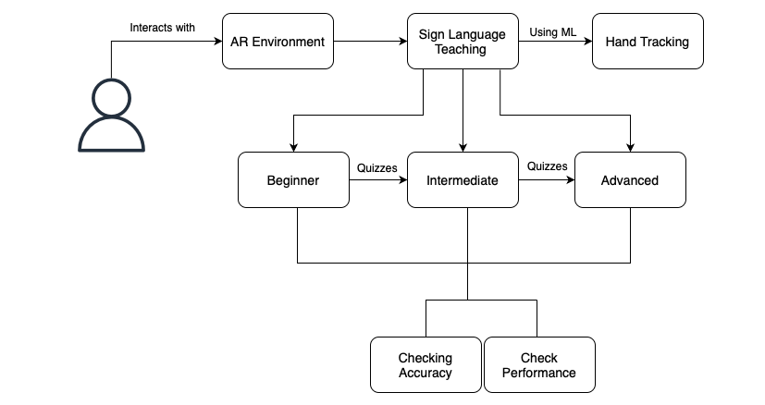
System Diagram
Rizan S – IT21311840
05.12.2024

Slide 16
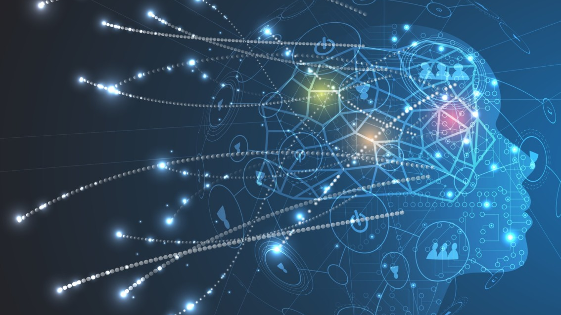
Technologies Used
Estimated Technologies
Machine Learning Model - VIT
Mobile Application - Flutter
Database - Firebase
Server - Fast API
3D Modelling - Blender, Maya, 3ds Max
General Environment
Python
Google Colab
Gitlab
16
Rizan S – IT21311840
05.12.2024

Slide 17
Evidence Of Completion
Rizan S – IT21311840
05.12.2024

Slide 18
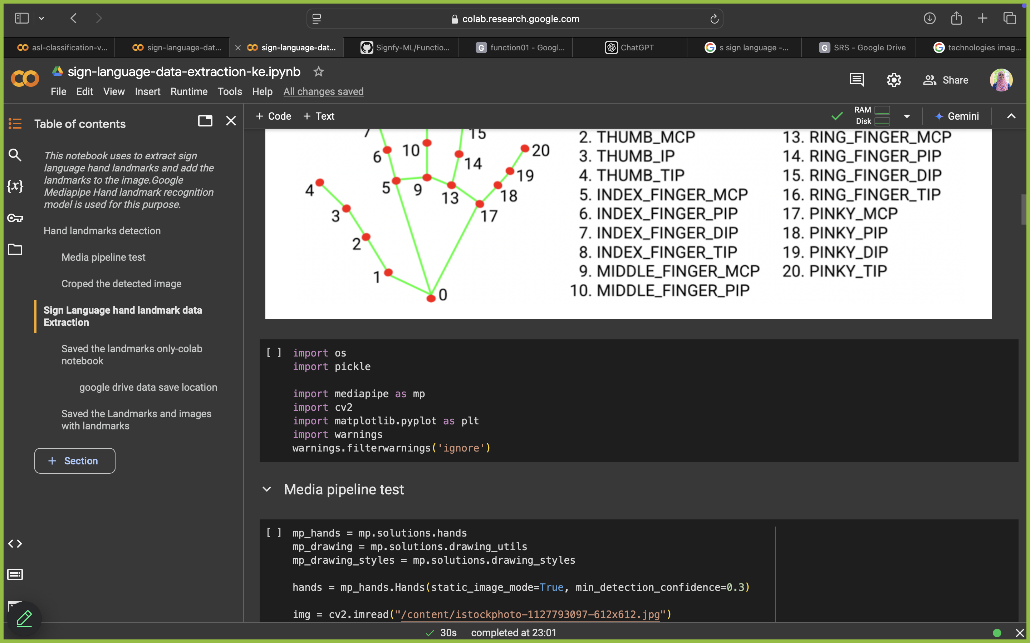
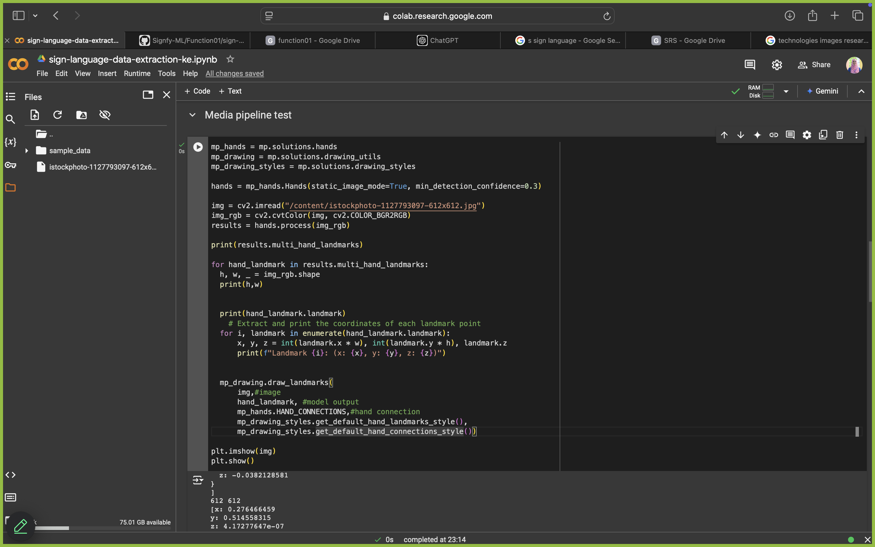
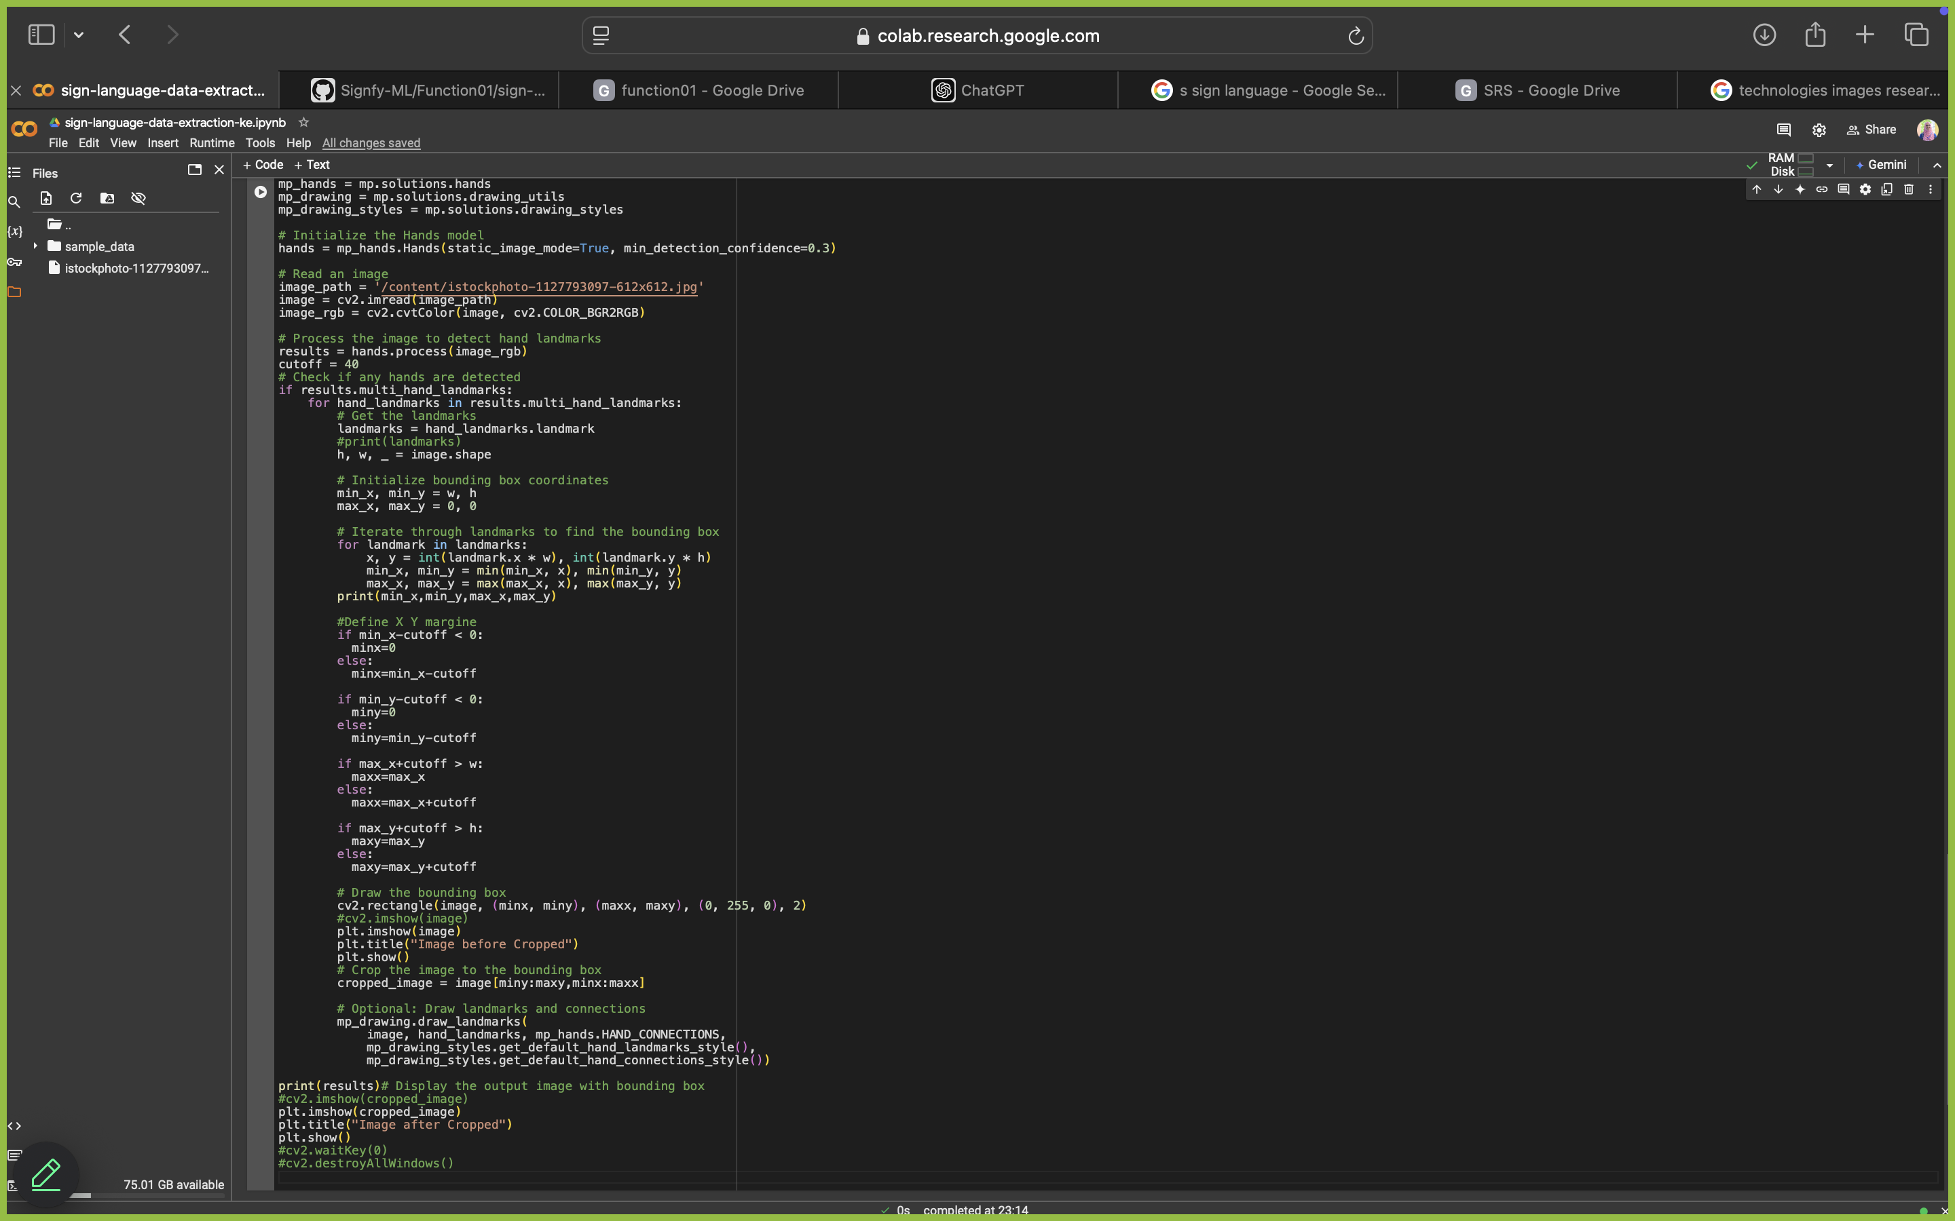
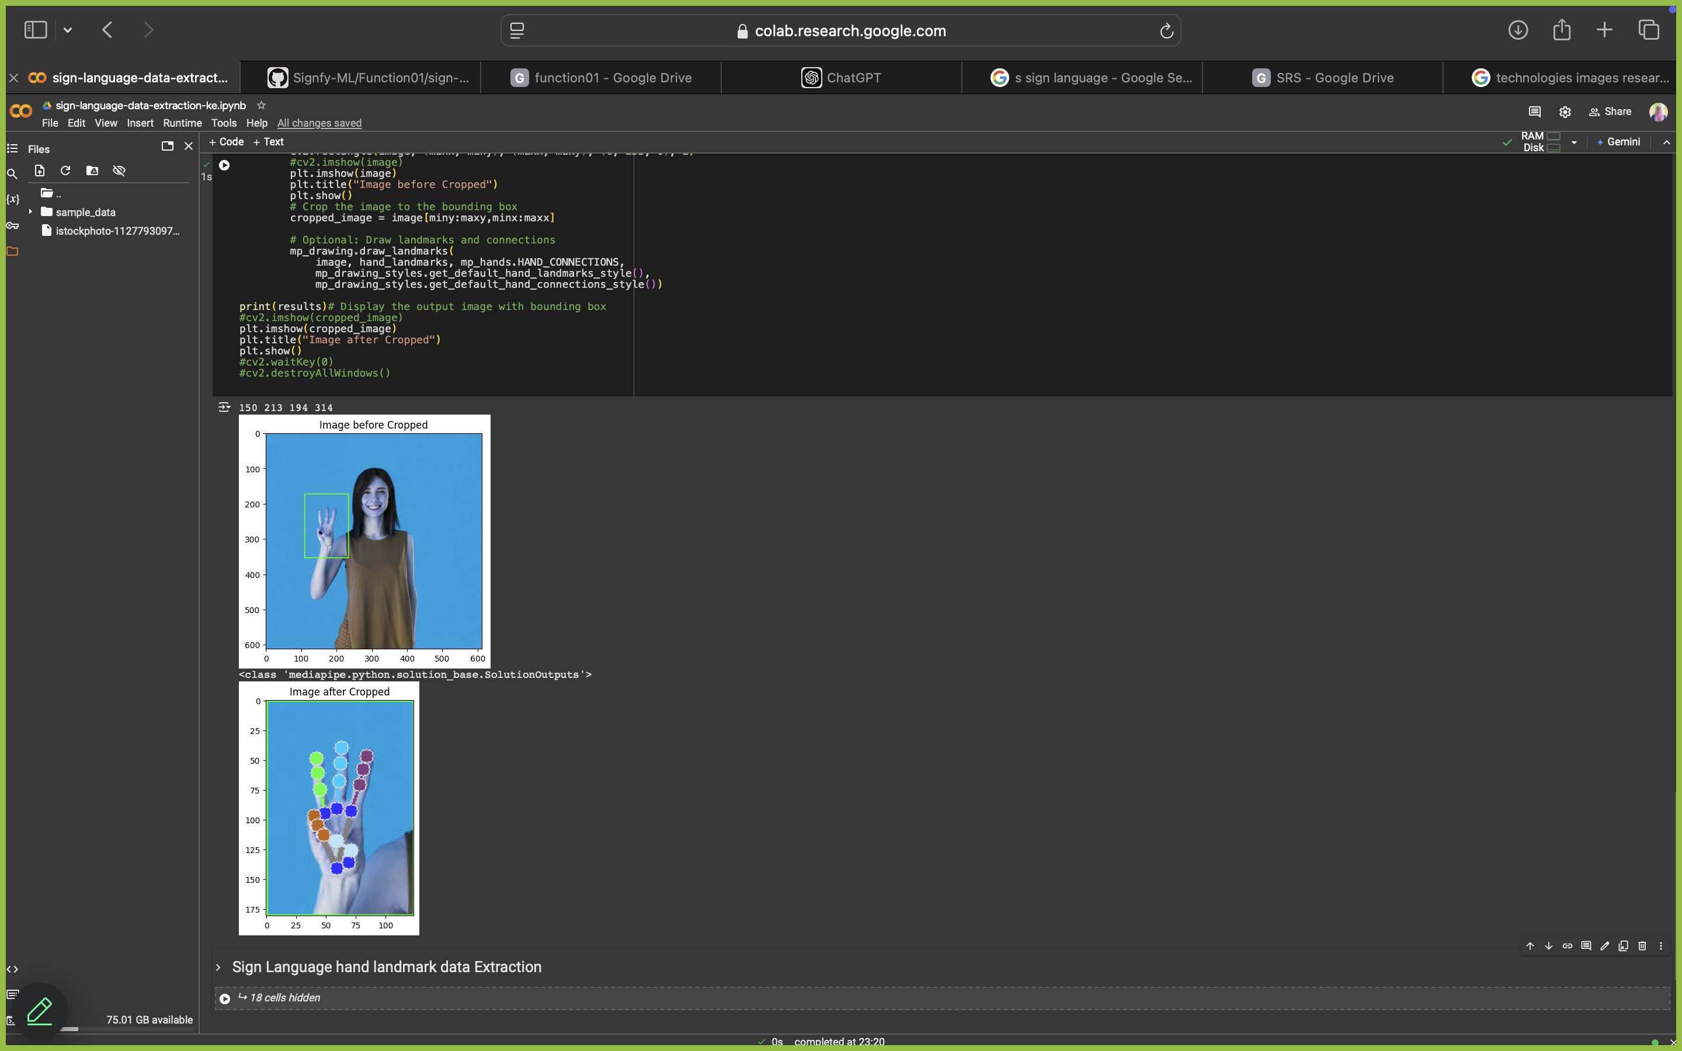
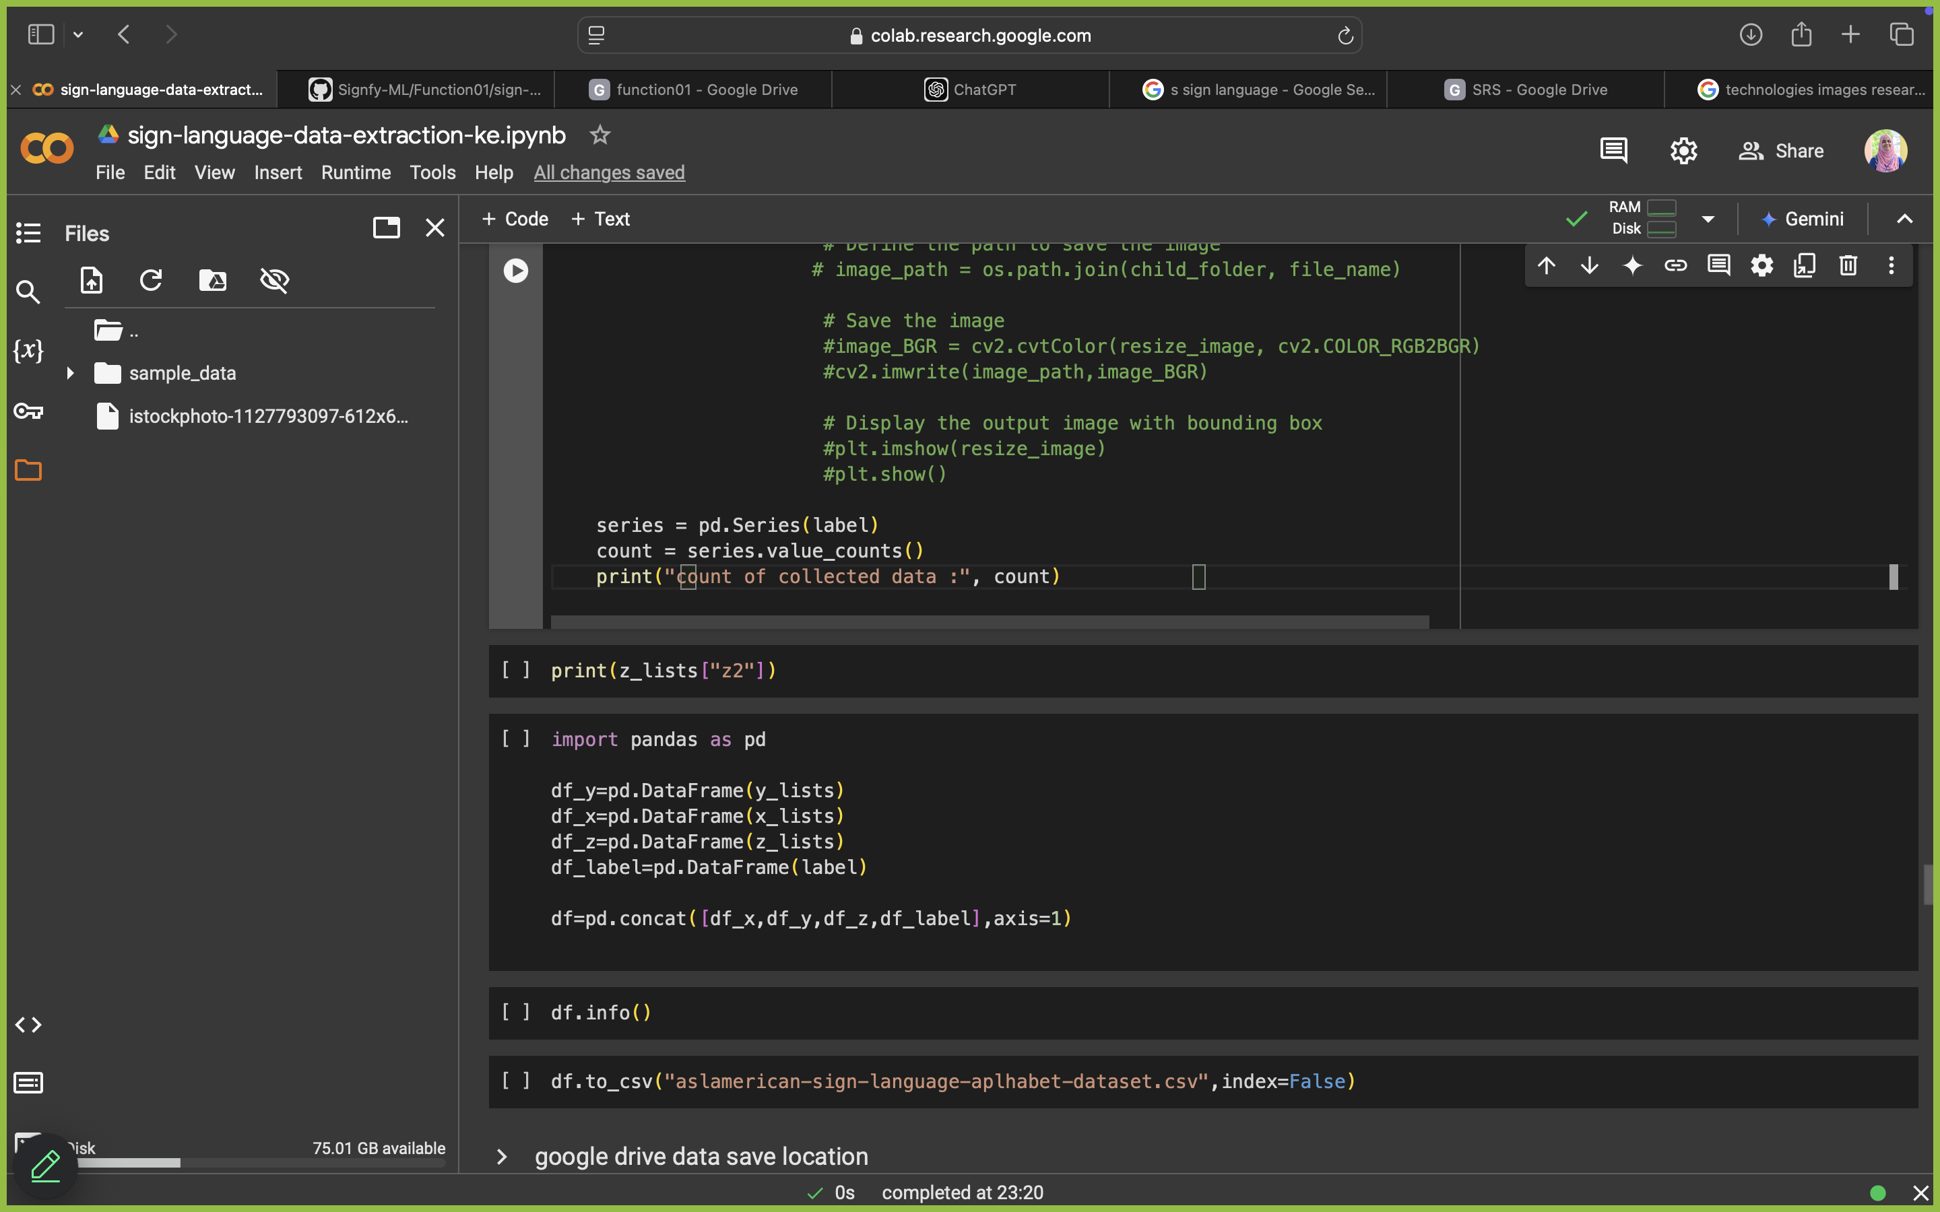
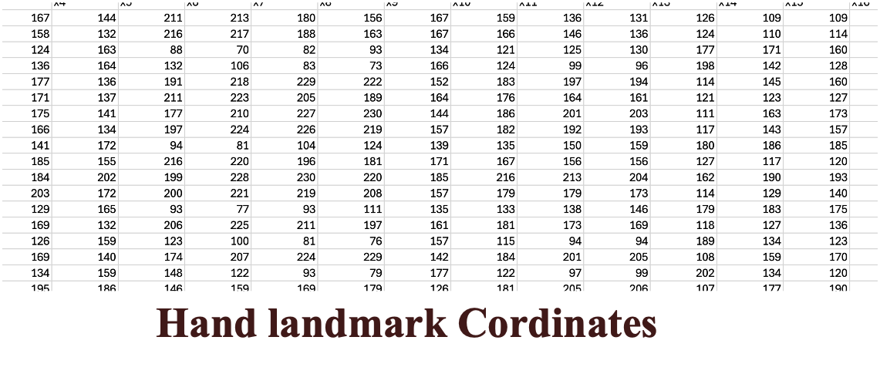
Data Preprocessing
Rizan S – IT21311840
05.12.2024

Slide 19
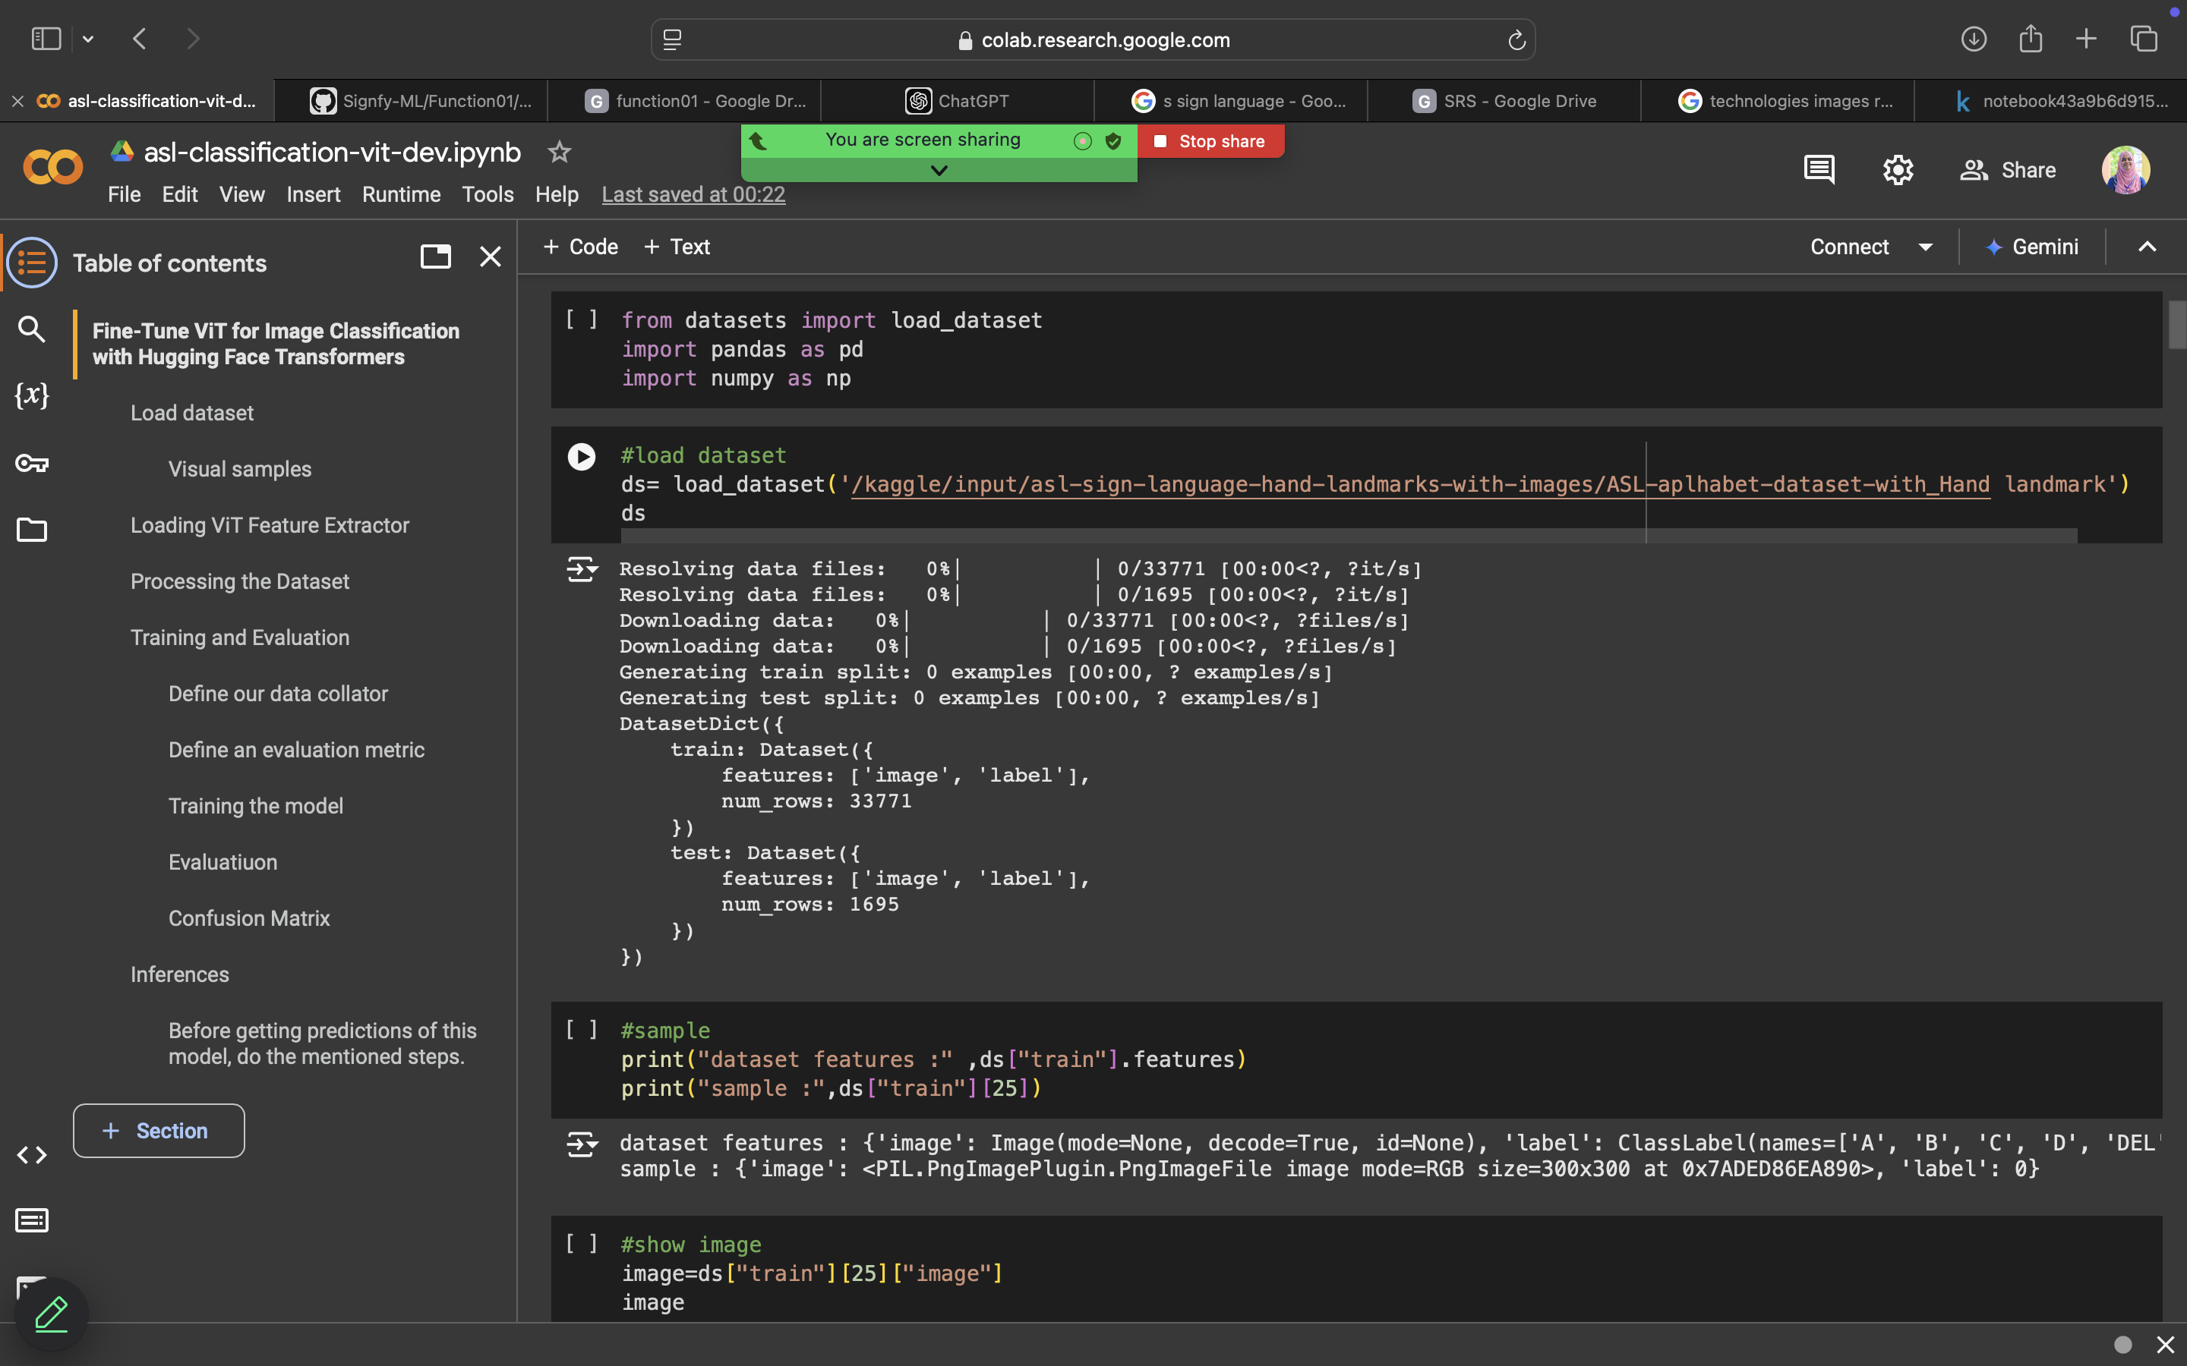
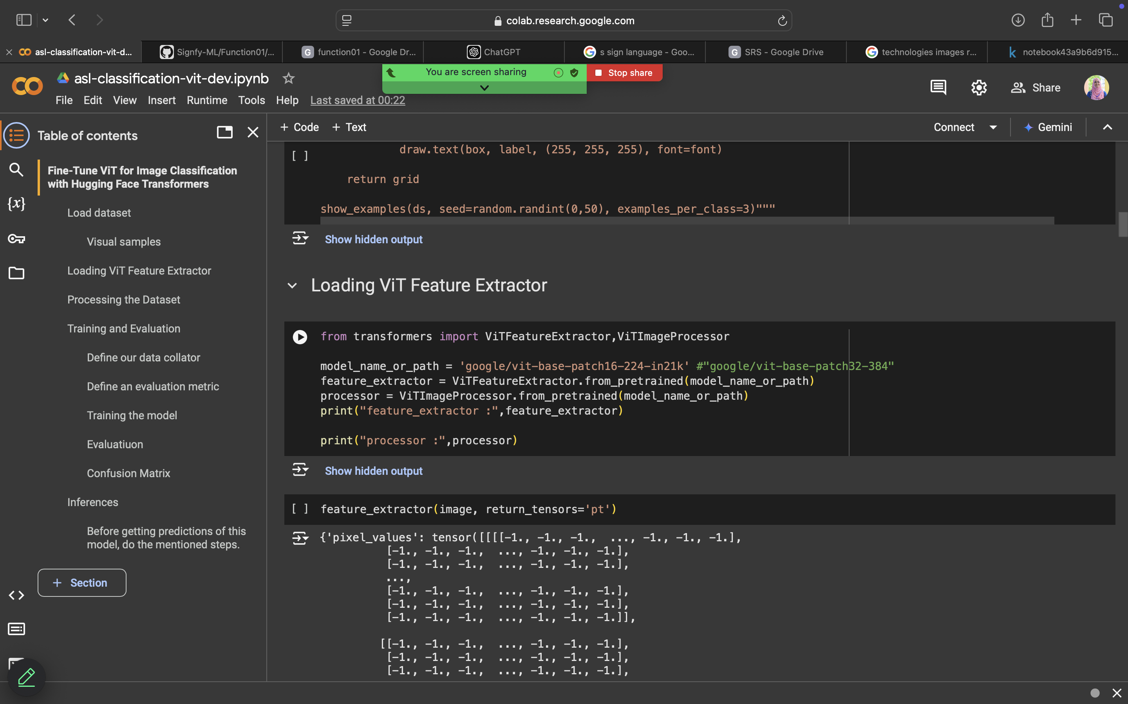
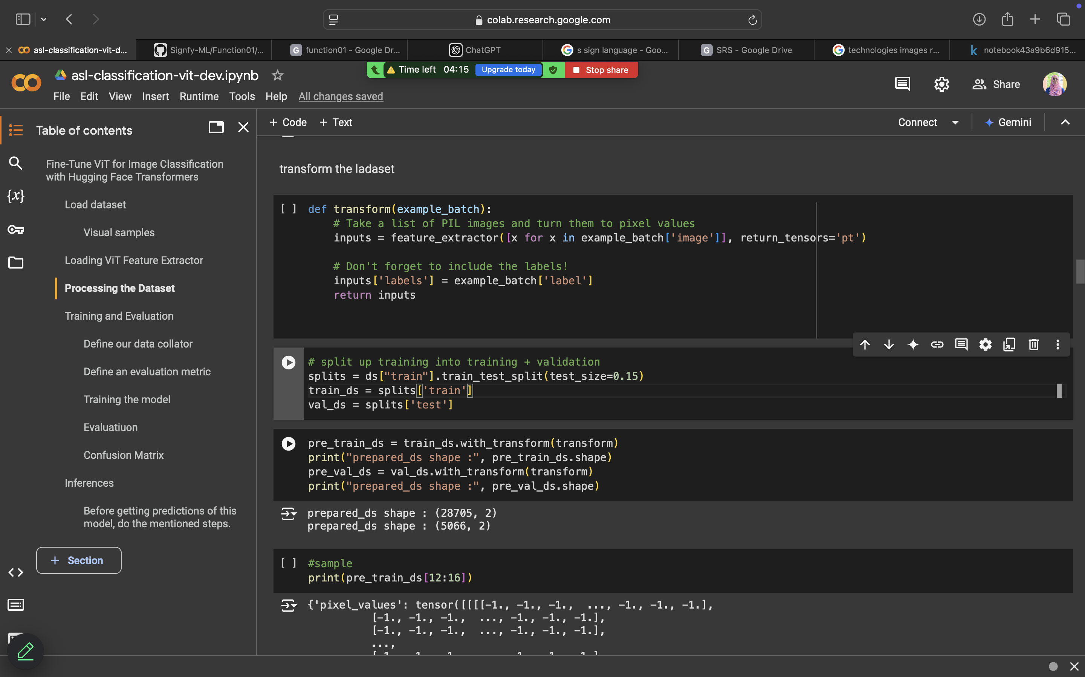
Fine-Tune VIT Model
Rizan S – IT21311840
05.12.2024

Slide 20
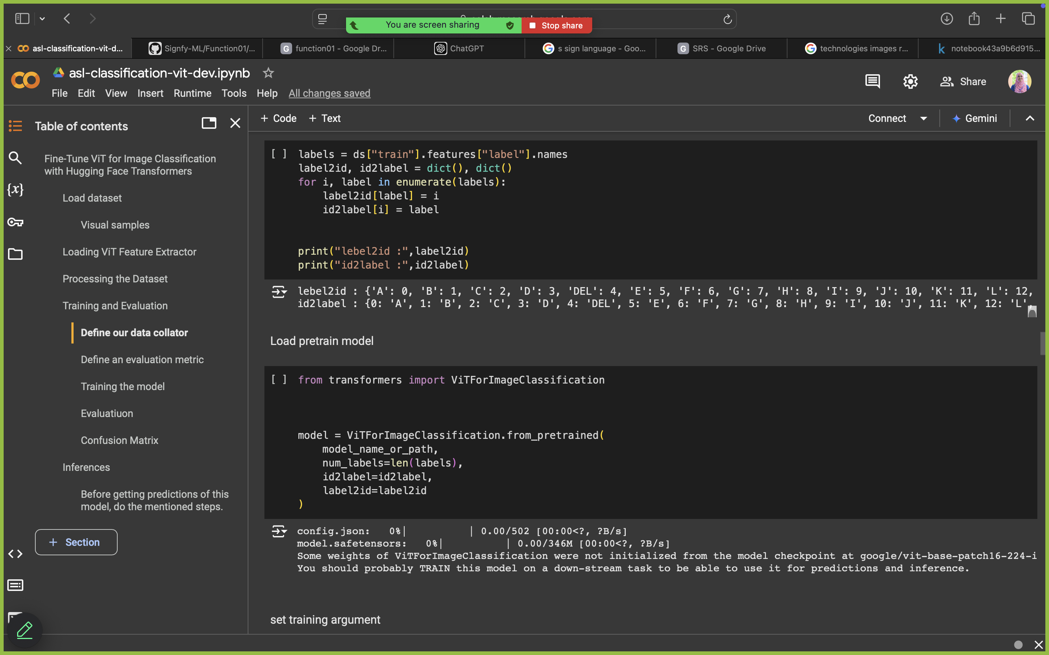
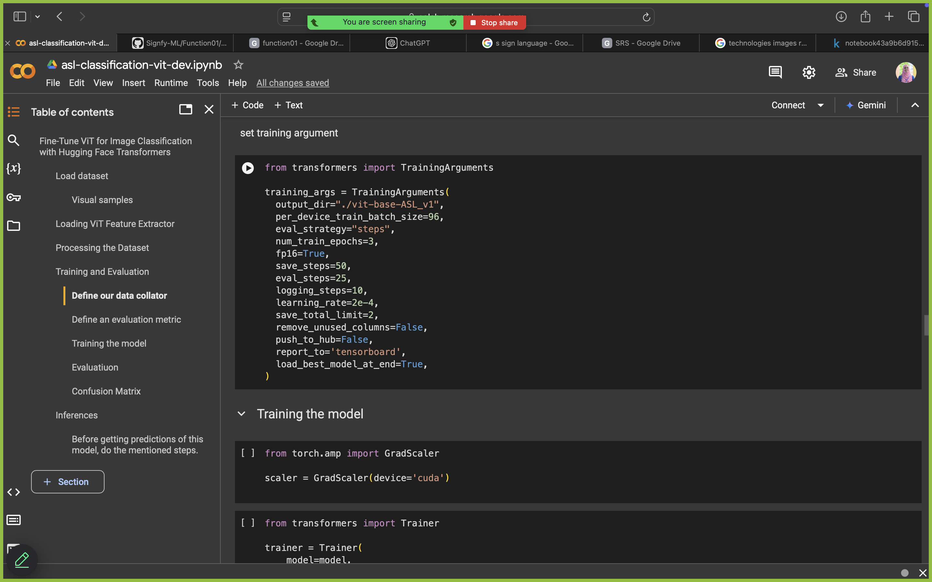
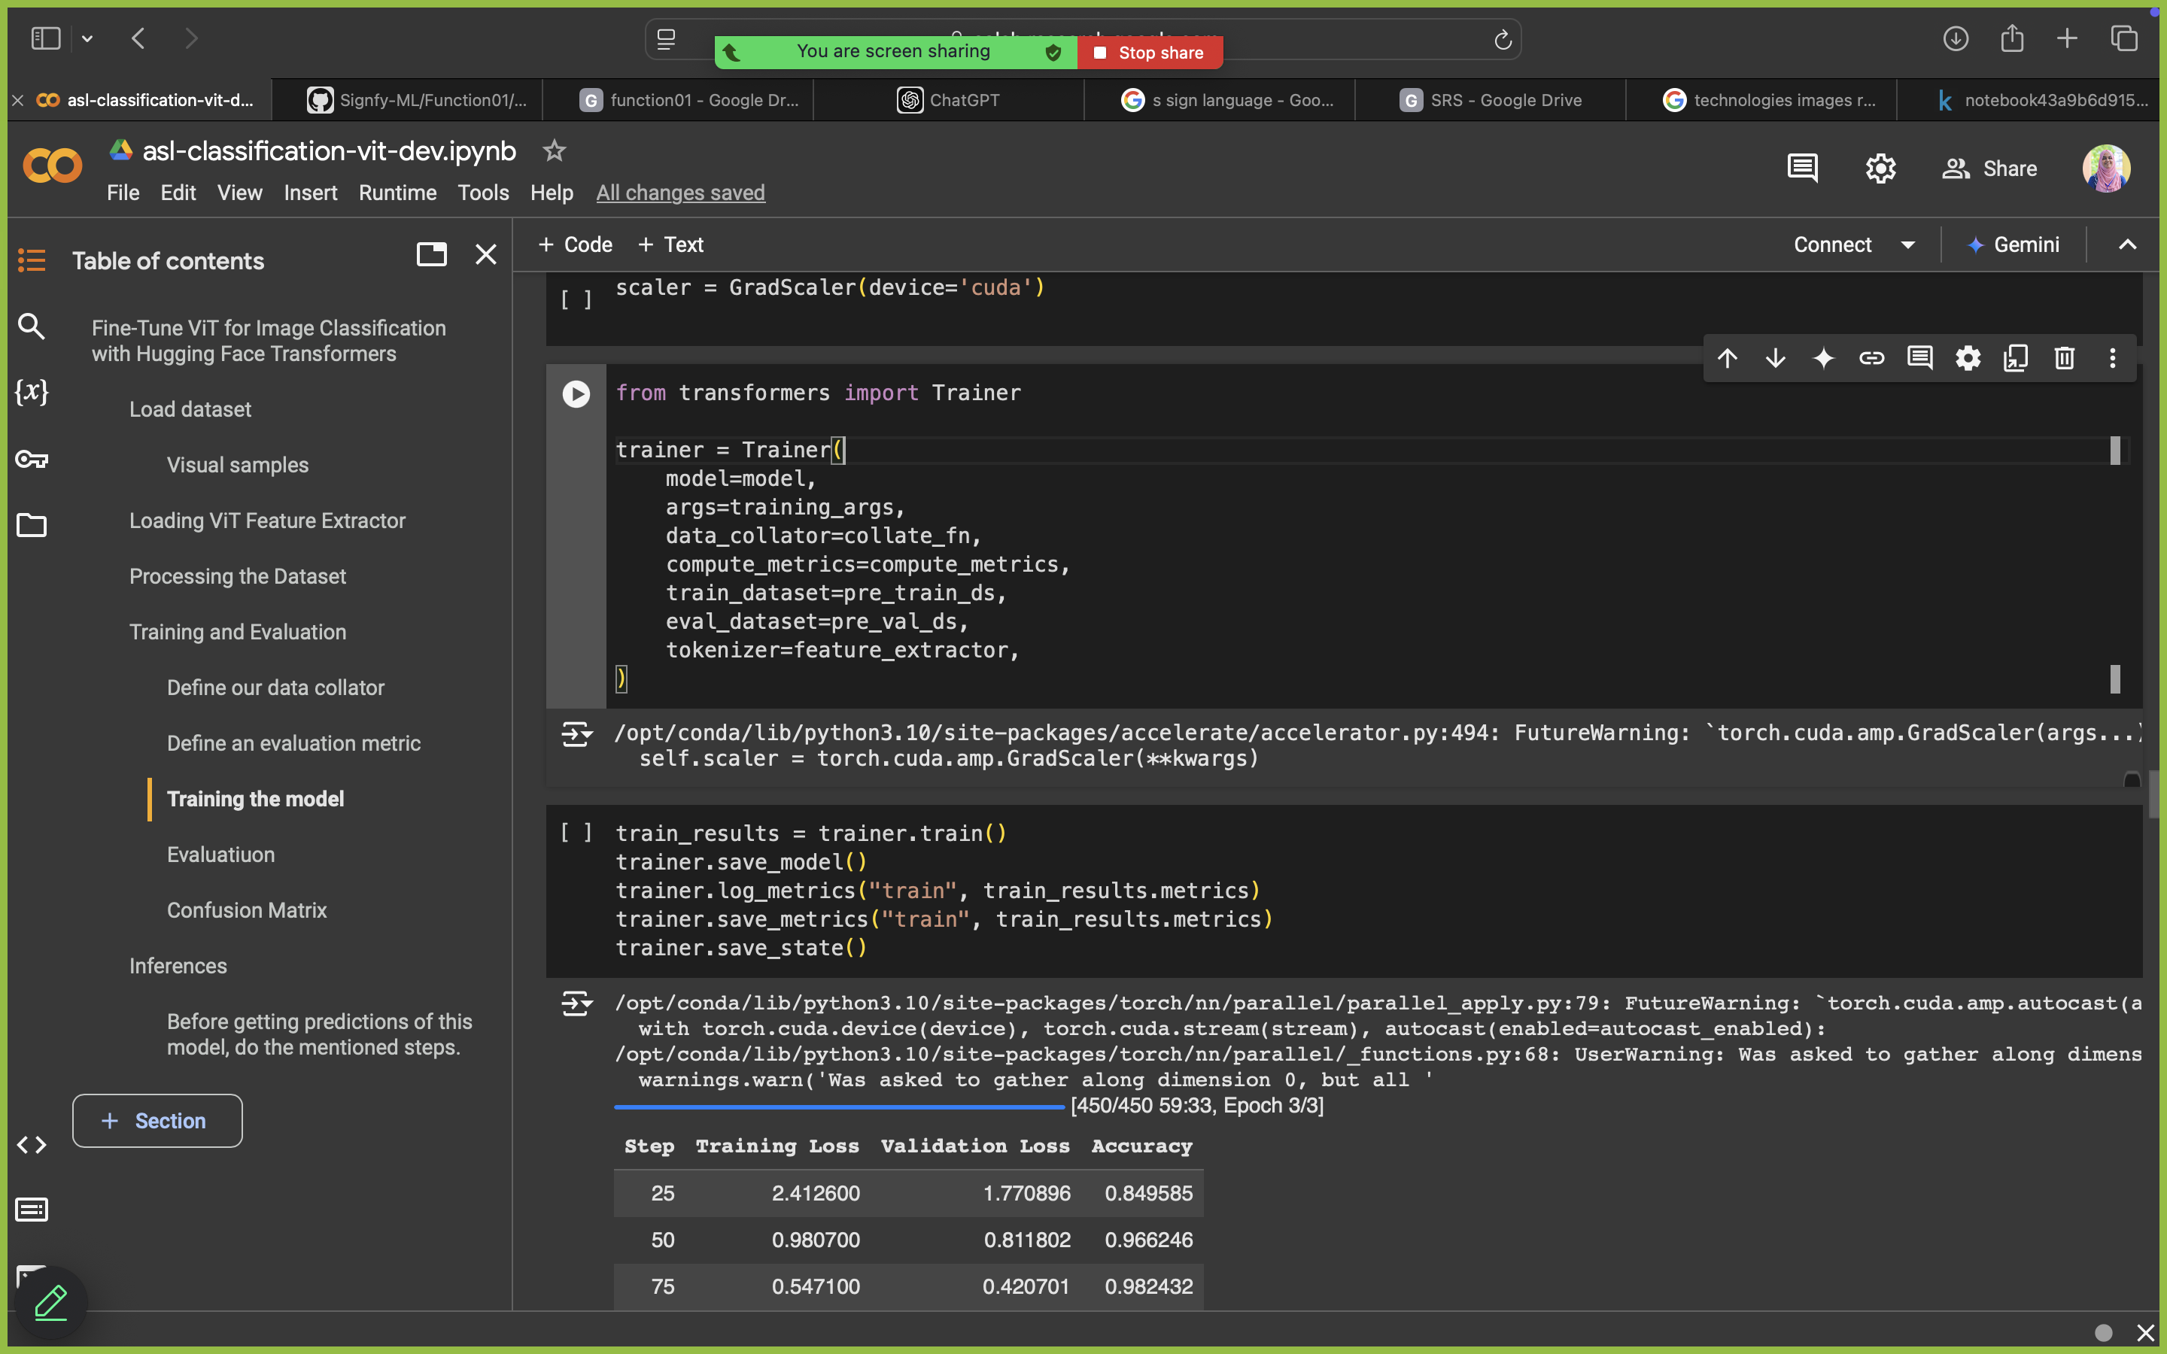
Model Building & Training
Rizan S – IT21311840
05.12.2024

Slide 21
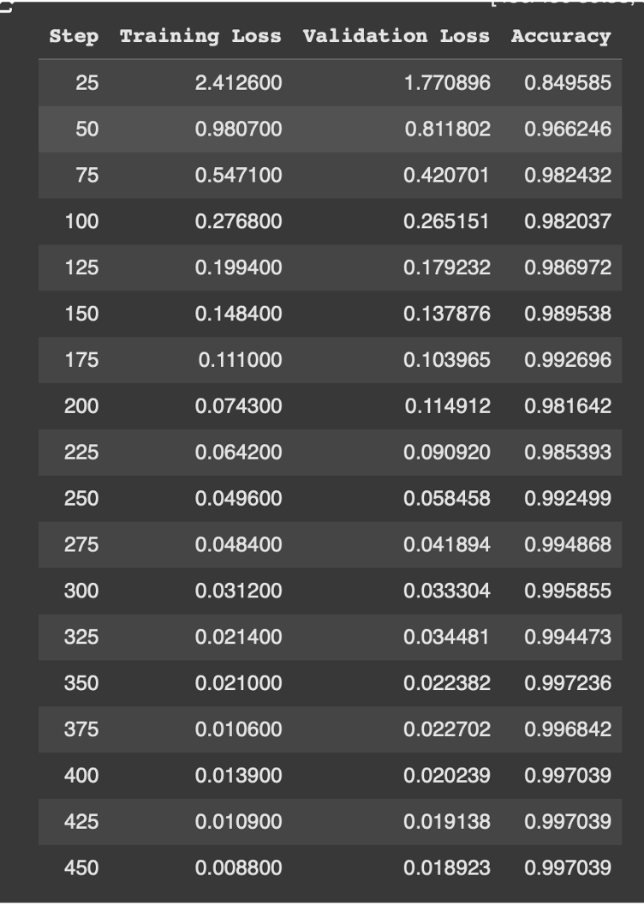
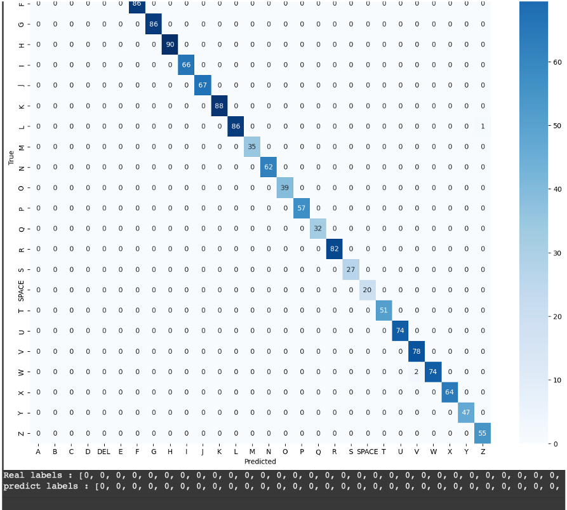
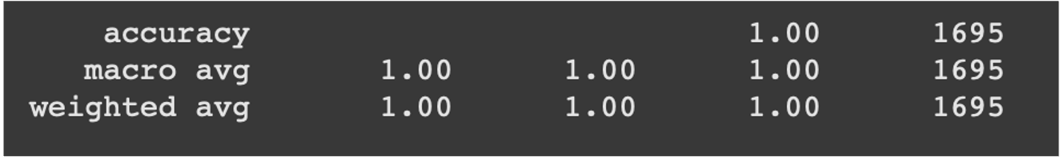
Accuracy
Classification Report
Evaluation
Confusion Matrix
Rizan S – IT21311840
05.12.2024

Slide 22
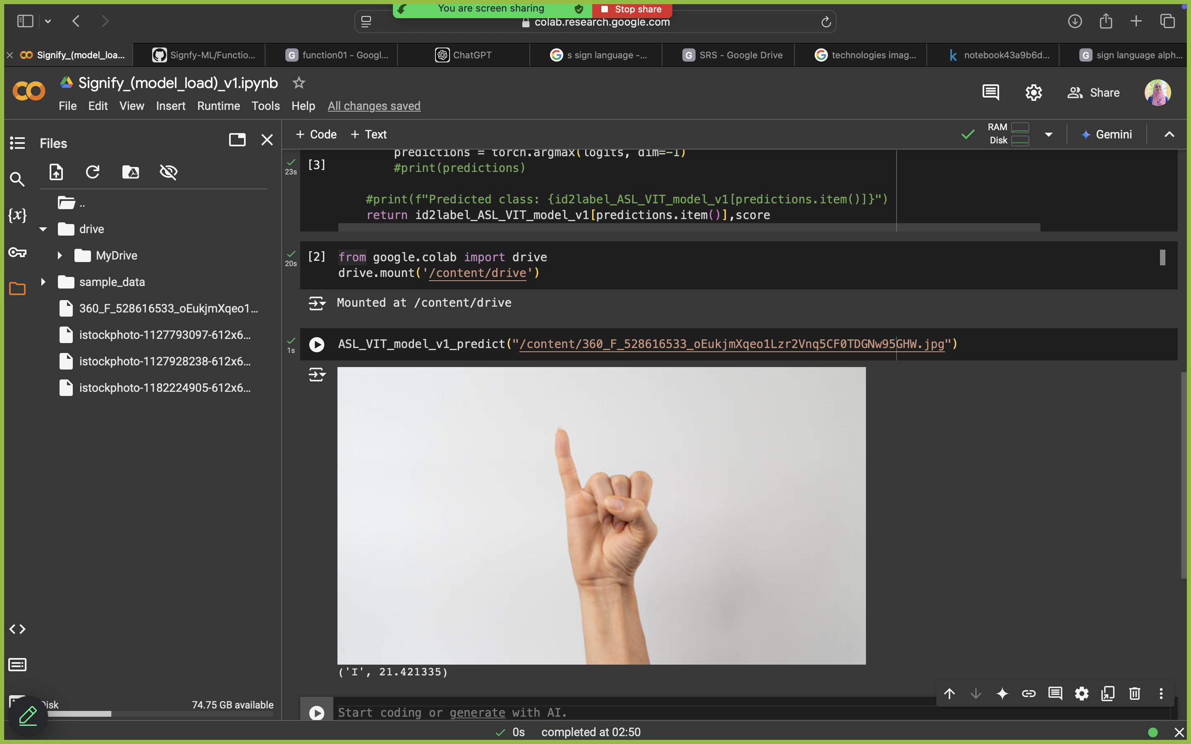
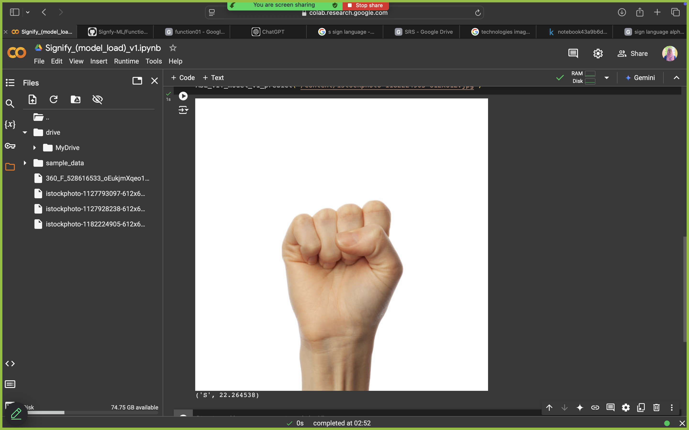
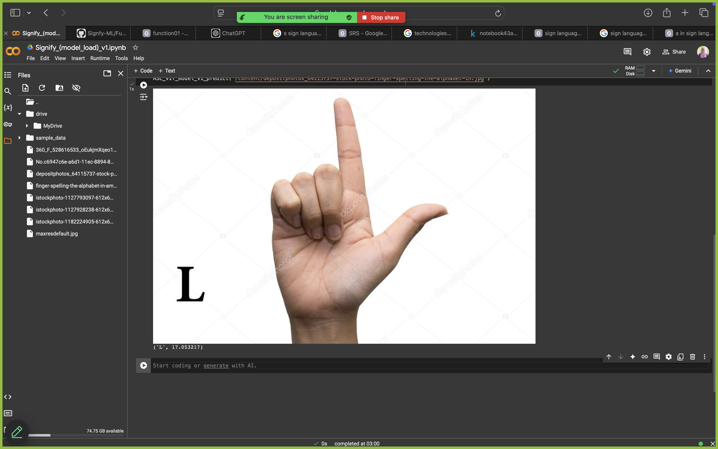
Prediction
Rizan S – IT21311840
05.12.2024

Slide 23
Future Checklist
Developing AR Environment
Rizan S – IT21311840
05.12.2024

Slide 24
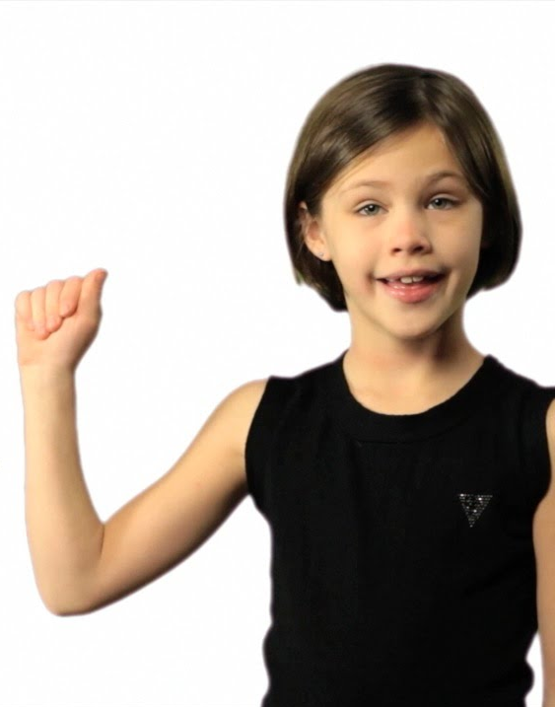
Requirements
Functional Requirements
Non - Functional Requirements
The system must process real-time data to generate immediate feedback during learning sessions.
The system should perform advanced computations required for AR interactions and machine learning algorithms.
Ensure smooth delivery of interactive AR content via a reliable network to support real-time interactions.
Develop and refine learning algorithms and AR interactions, tailored specifically for ASL learning.
High Performance
Graphics Processing
Network Reliability
Scalability
24
Rizan S – IT21311840
05.12.2024

Slide 25
References
[1] Kambhampati S. Sindhu, Mehnaaz, Biradar Nikitha, Penumathsa Likhita Varma, and Chandrasekhar Uddagiri, "Sign Language Recognition and Translation Systems for Enhanced Communication for the Hearing Impaired," in Proc. 1st International Conference on Cognitive, Green, and Ubiquitous Computing (IC-CGU), 2024, pp. 1-8.
[2] MMK Rowel, ADAI Gunasekara, GAI Uwanthika, and DB Wijesinghe, "An E-Learning Platform for Hearing Impaired Children," Faculty of Computing, General Sir John Kotelawala Defence University, Ratmalana, Sri Lanka, 2023.

Slide 26
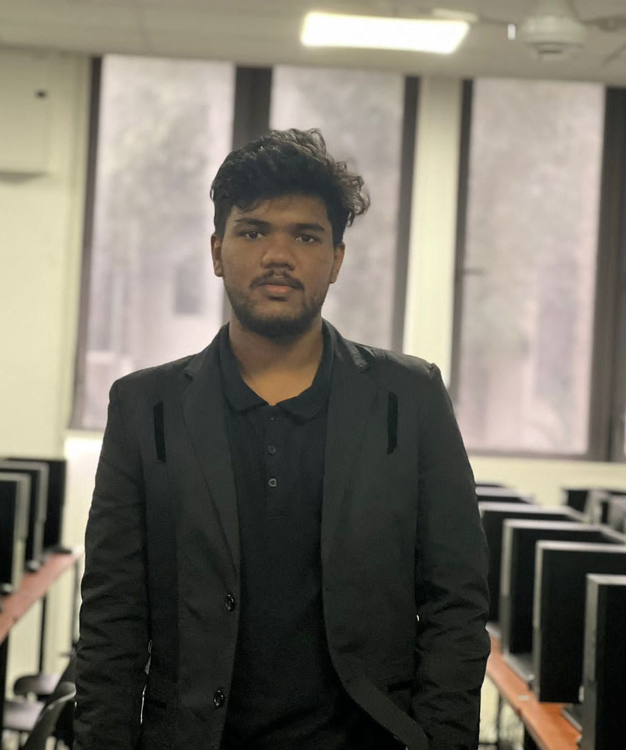
MSM Shazny - IT21173622
Specialization : Data Science
26
MSM Shazny - IT21173622
05.12.2024

Slide 27
Background
Hearing-impaired students face barriers in traditional e-learning environments due to auditory-based content.
Limited integration of sign language and captions in real-time on a single platform.
Need for inclusive tools to enhance accessibility and learning outcomes.
27
MSM Shazny - IT21173622
05.12.2024

Slide 28
Research Gap
Existing solutions either focus on captions or sign language but rarely integrate both in real-time.
Lack of advanced AI for accurate, context-aware sign language animations.
Limited platforms offering real-time synchronization of captions, sign language, and video playback​
MSM Shazny - IT21173622
05.12.2024

Slide 29
Research Question
How can real-time translation of educational content into captions and sign language enhance accessibility for hearing-impaired students?
MSM Shazny - IT21173622
05.12.2024

Slide 30
Specific & Sub Objectives
Develop a system that converts educational video audio into real-time captions and sign language while ensuring synchronization.
Implement speech recognition models for real-time caption generation.
Translate spoken content into synchronized sign language using advanced AI.
Summarize video content to provide key points at the end.
30
MSM Shazny - IT21173622
05.12.2024

Slide 31
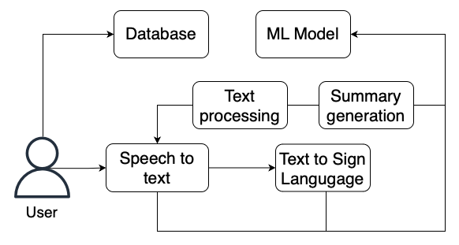
System Diagram
MSM Shazny - IT21173622
05.12.2024

Slide 32
Technologies Used
Estimated Technologies
Machine Learning Model – Conditional Gans(CGans)
Mobile Application - Flutter
Database - Firebase
Server - Fast API
3D Modelling - Blender, Maya, 3ds Max
General Environment
Python
Google Colab
Gitlab
32
MSM Shazny - IT21173622
05.12.2024

Slide 33
Evidence Of Completion
MSM Shazny - IT21173622
05.12.2024

Slide 34
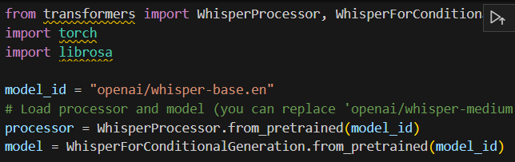
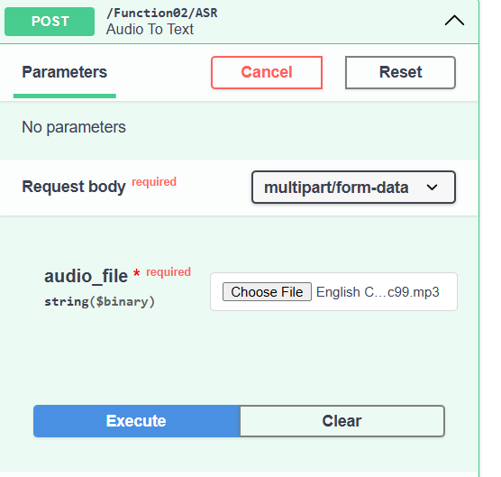
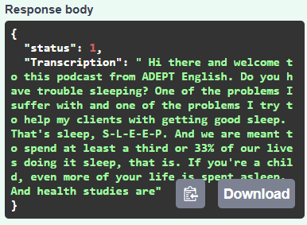
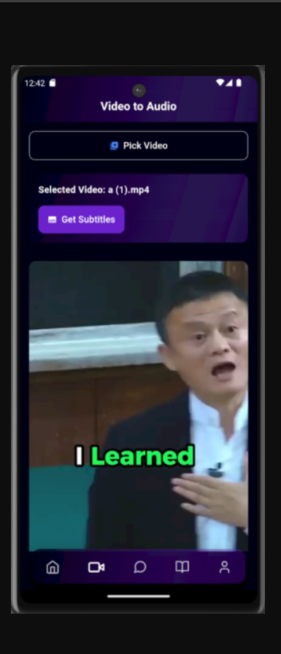
Speech to text
User Interface
MSM Shazny - IT21173622
05.12.2024

Slide 35
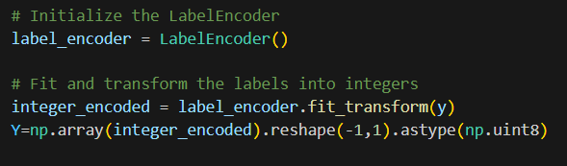
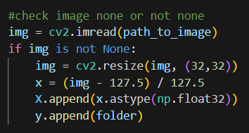
GANS mode Data Preprocessing
Resizing Images and Normalizing
MSM Shazny - IT21173622
05.12.2024

Slide 36
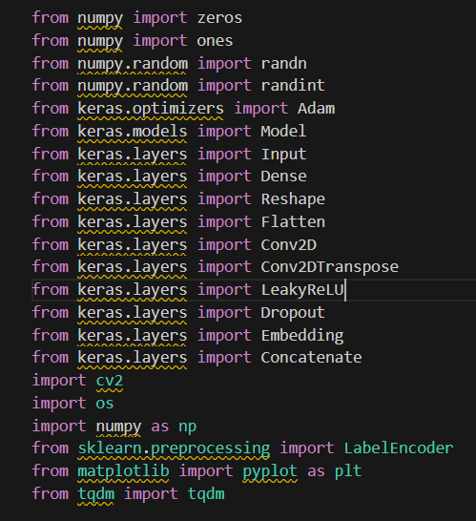
Libraries Imported
MSM Shazny - IT21173622
05.12.2024

Slide 37
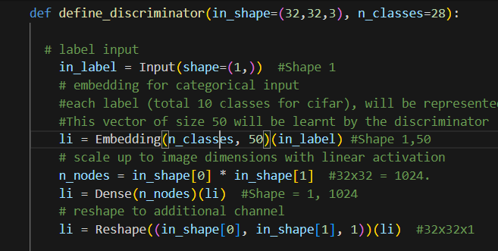
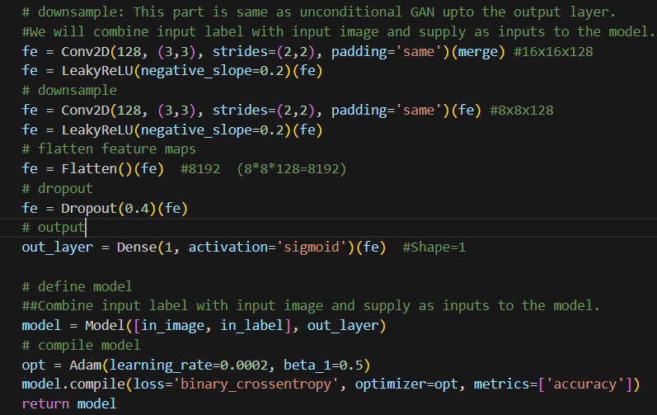
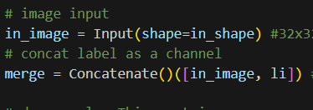
Discriminator model
Rizan S – IT21311840
05.12.2024

Slide 38
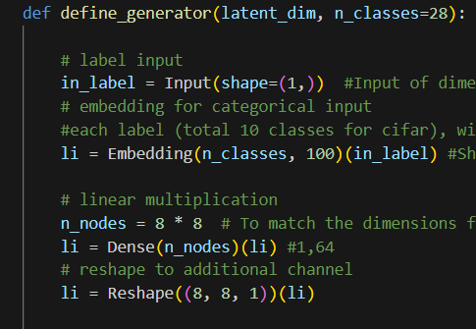
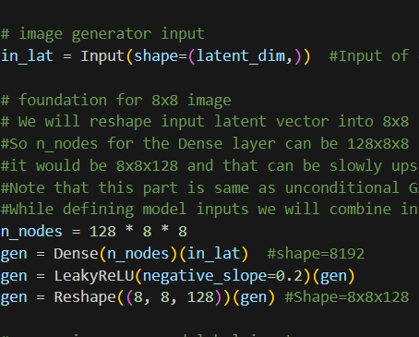
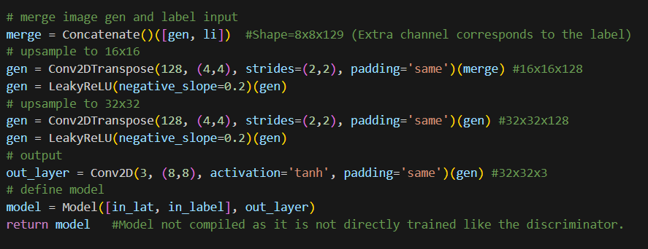
Generator model
Rizan S – IT21311840
05.12.2024

Slide 39
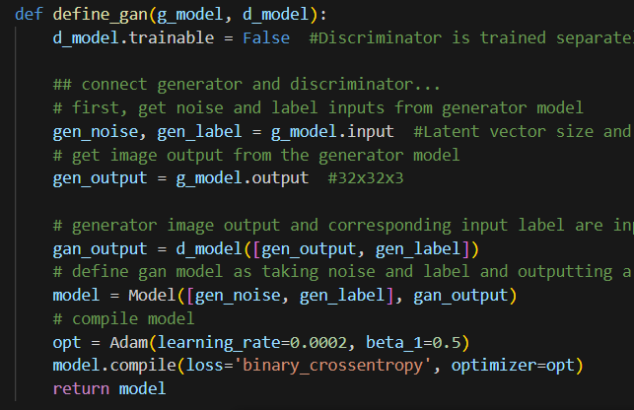
Combined model
Rizan S – IT21311840
05.12.2024

Slide 40
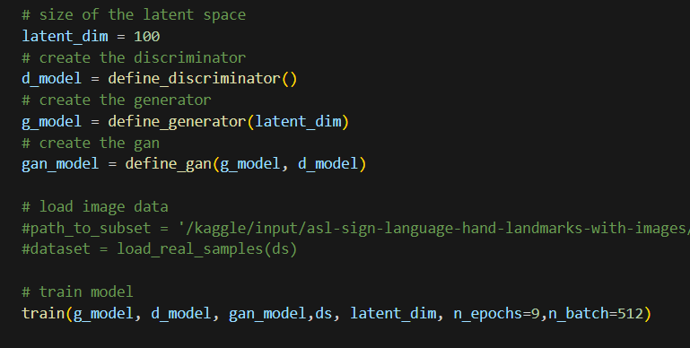

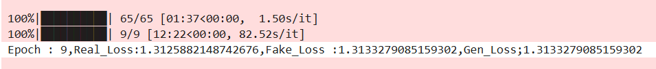
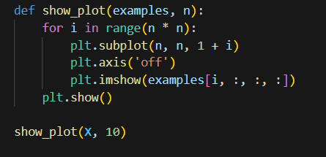
Training the Model
Rizan S – IT21311840
05.12.2024

Slide 41
Future Checklist
Improves the Gans Model
Synchronize within audio, sign language gestures in real time
Summarization
MSM Shazny - IT21173622
05.12.2024

Slide 42
Requirements
Functional Requirements
Non - Functional Requirements
The system shall synchronize the display of sign language gestures with the spoken content and captions in real-time
The system shall integrate these summaries with sign language translations and captions for comprehensive learning support.
The system shall provide a user-friendly interface that allows easy navigation between captions, sign language translations, and summaries.
Scalability
Reliability and Availability
Security
42
Rizan S – IT21311840
05.12.2024

Slide 43
References
[1] "An E-Learning Platform for Hearing Impaired Children," details the limitations of current systems in integrating captions and sign language.
[2] "Sign Language Recognition and Translation Systems for Enhanced Communication for the Hearing Impaired," discusses the need for more advanced AI techniques in sign language translation.
[3] "E-Learning Model to Identify the Learning Styles of Hearing-Impaired Students," highlights the absence of integrated summarization tools in educational platforms for hearing-impaired students.
[4] "Hastha Online Learning Platform for Hearing Impaired," underscores the challenges in scaling and adapting systems to various educational environments.

Slide 44
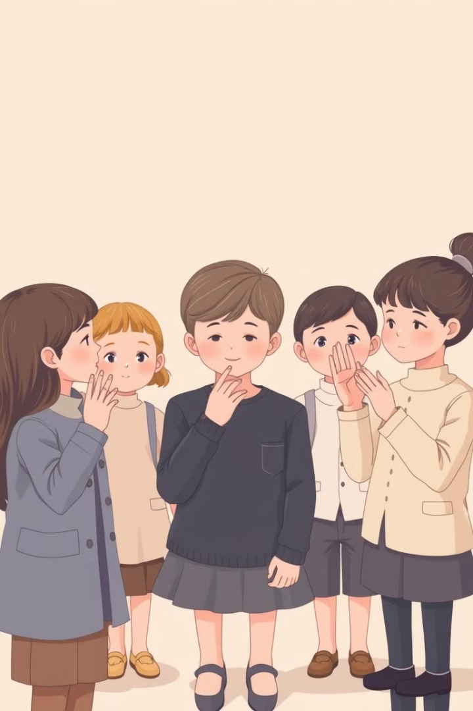
Function 3
AI-powered Learning Assistant with Sign Language Support & Recommendations with Performance Prediction

Slide 45
Research Problem
Lack of real-time performance analysis and future predictions for continuous improvement.
Lack of personalized learning tools for users based on their performance.
Difficulty in predicting improvement and recommending personalized resources.

Slide 46
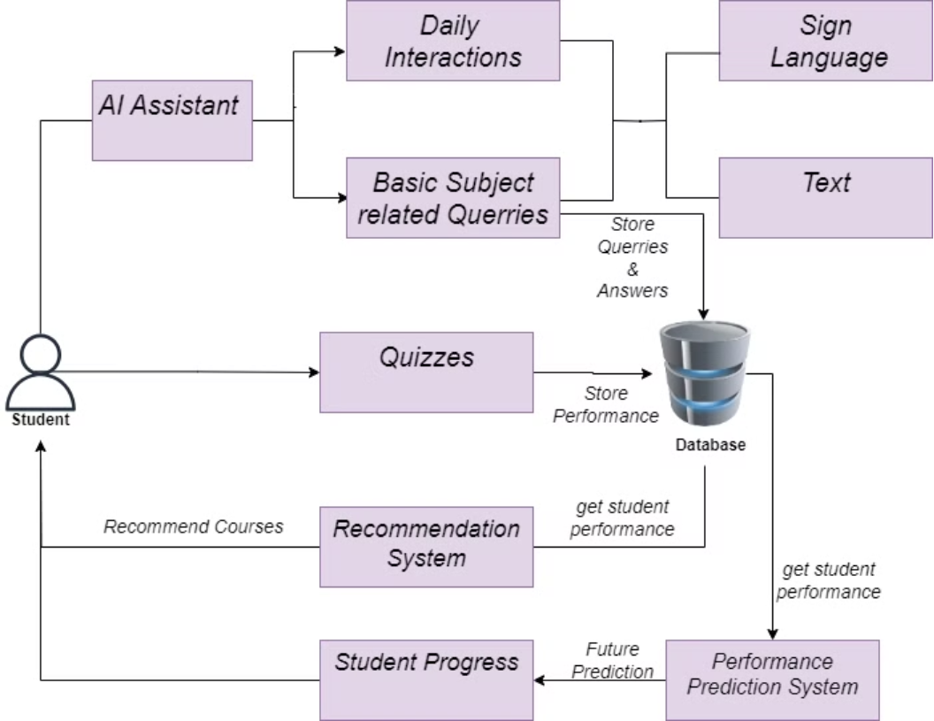
Component Diagram

Slide 47

Main Objectives
1
Develop an AI-powered chatbot to provide interactive study assistance, making learning more engaging and personalized.
2
Implement a recommendation system that suggests personalized courses based on user scores and performance.
3
Build a system to predict future performance and track the improvement of users’ skills through game-based learning.

Slide 48
Sub Objectives
Chatbot
2
Recommendation System
Performance Prediction System
Engage users in educational conversations.
Filter courses by subjects (English, Mathematics).
Calculate current performance (game score and improvement score).
Explain scientific concepts in simple terms.
Map quiz scores to corresponding course levels (Beginner, Intermediate, Advanced).
Answer user queries and suggest ways to relate concepts to real-world scenarios.
Predict future performance based on historical data (game sessions).
Use cosine similarity to match user performance with the most relevant courses.
Provide personalized insights into future improvement.
1
3

Slide 49

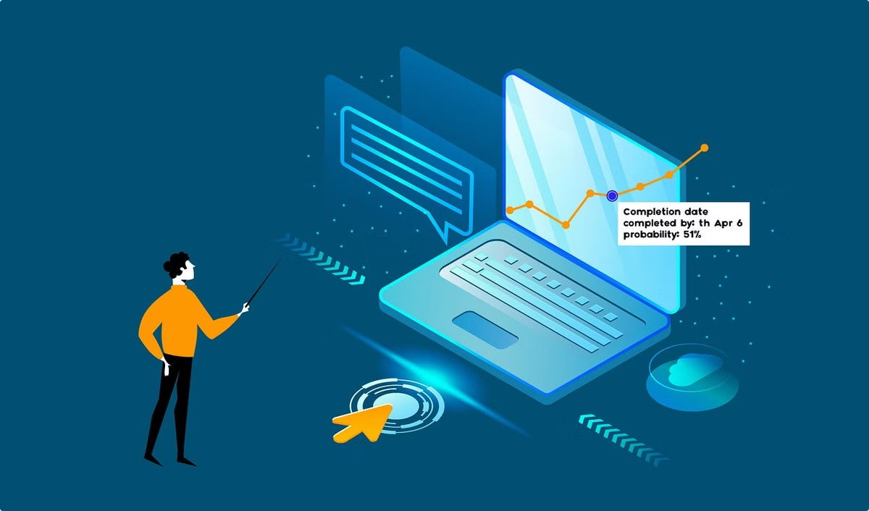
Evidence of Completion

Slide 50
Chatbot

Slide 51
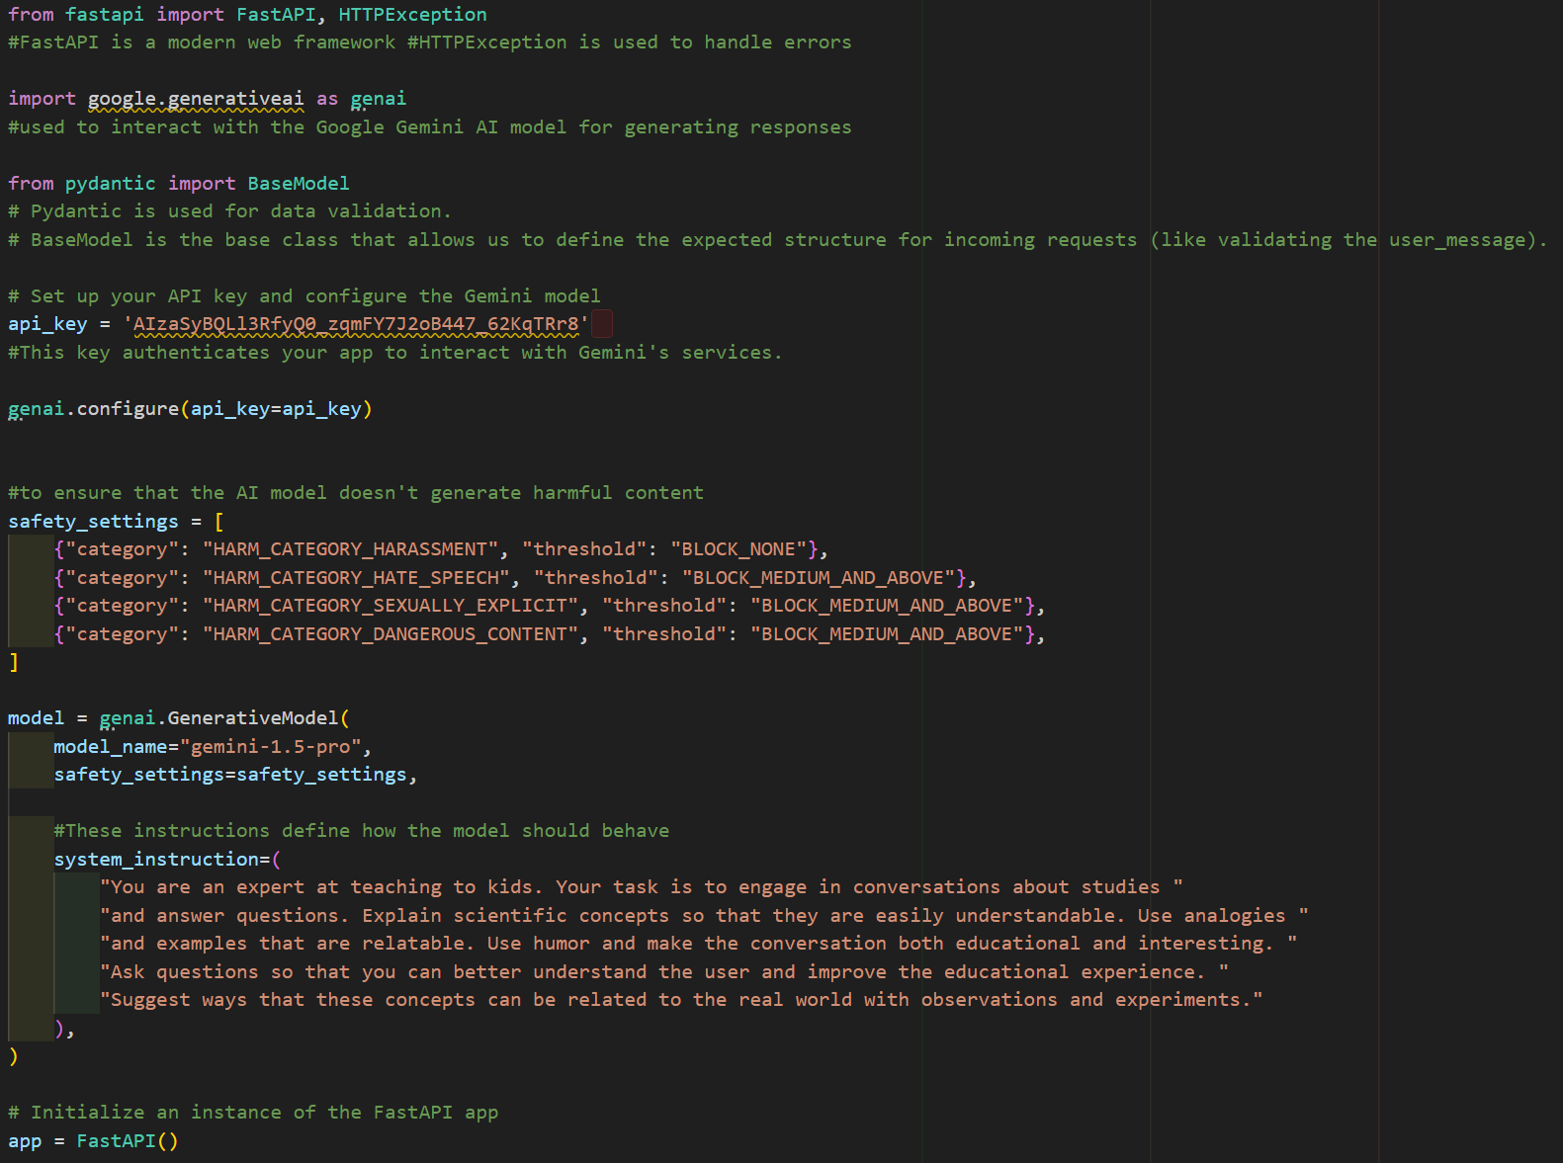

Slide 52

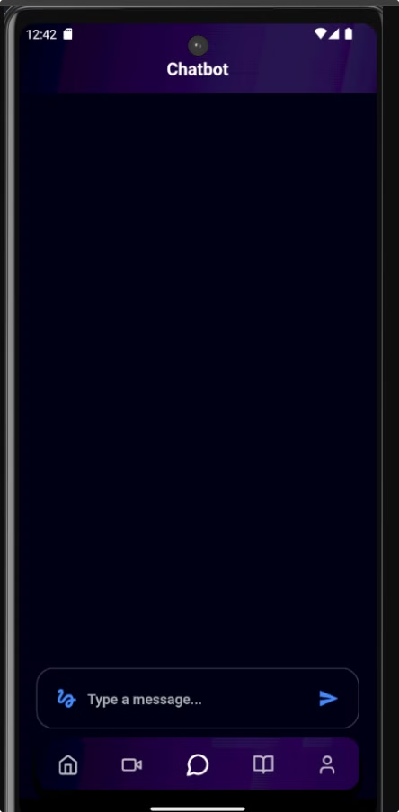
UI design

Slide 53

Chatbot
Integrated a chatbot system with Gemini API, which engages users in educational conversations.

Slide 54
Recommendation System

Slide 55


Slide 56


UI Design

Slide 57



Recommendation System
Built a system that recommends courses based on quiz scores (English, Mathematics).

Slide 58
Performance Prediction System

Slide 59

Generating Synthetic dataset

Slide 60


Slide 61

Data Preprocessing

Slide 62


Slide 63


Improvement Score Prediction using Linear Regression model
Accuracy of the model

Slide 64



UI Design

Slide 65




Performance Prediction System
Developed a system that calculates current game performance and predicts future improvement based on past data using ARIMA.
Score Calculation
Self Improvement

Slide 66
Technologies
1
Chatbot
2
Recommendation System
3
Performance Prediction System
Libraries
FastAPI
Libraries
Libraries
Google Gemini API
FastAPI
pmdarima (ARIMA)
Pydantic
scikit-learn (TF-IDF)
scikit-learn
HTTPException
Cosine Similarity
Pandas
Joblib
Joblib
Pandas
NumPy
Matplotlib

Slide 67
Future Works
Chatbot
1
Build the chatbot from scratch without Gemini AI.
Add sign language and text communication for improved accessibility.
2
Recommendation System
Enhance interactivity and personalization for educational use.
Generate games to recommend courses based on student performance.
Use chatbot interactions to assess student levels and recommend suitable courses.
Performance Prediction System
3
Recommendation Transparency.
Develop the system to recommend based on the age.
Generate games to calculate improvement scores and predict future performance.
Advanced Time-Series Forecasting.

Slide 68
System & Software Requirements
Hardware
Software
Cloud Infrastructure
Minimum 4GB RAM
Python 3.x
For real-time data: Firebase setup for data storage
CPU: Intel i5 or higher for moderate load
Libraries: scikit-learn, pmdarima, FastAPI, joblib, pandas, numpy
Storage: 10GB free space for development and model storage
IDE: VS Code, Jupyter Notebook

Slide 69

References
Koren Koren, Y., Bell, R., & Volinsky, C. (2009). Matrix Factorization Techniques for Recommender Systems. IEEE Computer Society. DOI: 10.1109/ICDM.2009.124
Karatzoglou, A., et al. (2019). A Survey on Deep Learning for Recommender Systems. ACM Computing Surveys. DOI: 10.1145/3293663
Siegel, E. (2013). Predictive Analytics: The Power to Predict Who Will Click, Buy, Lie, or Die. Wiley.
LeCun, Y., Bengio, Y., & Hinton, G. (2015). Deep Learning. Nature, 521(7553), 436-444. DOI: 10.1038/nature14539

